Slide 1

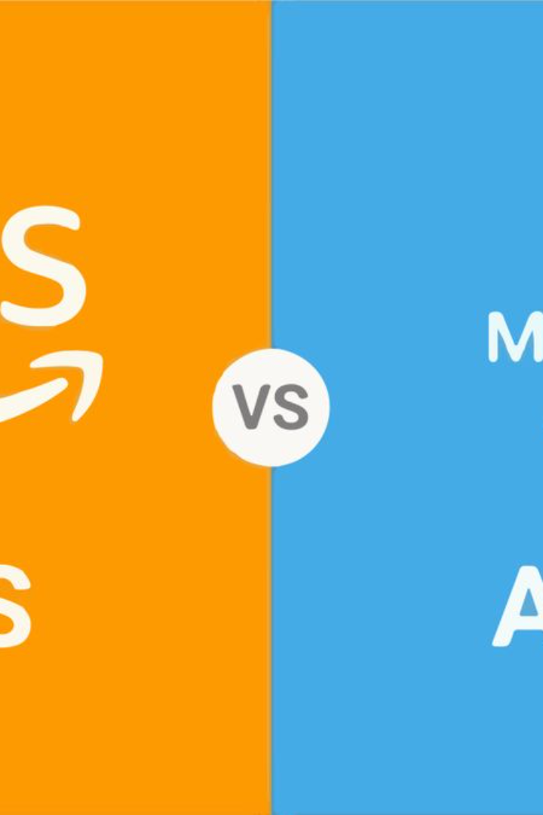
AWS and Azure DevOps
This presentation discusses the DevOps services offered by AWS and Azure, providing insights into their features, benefits, and best practices.
B
by Bathina Siva Prasad Reddy

Slide 2

Overview of AWS DevOps
Services Integration
Scalability
Security
AWS DevOps integrates various services like AWS CodePipeline, AWS CodeBuild, and AWS CodeDeploy to automate the software delivery process.
With AWS DevOps, scaling resources up or down based on demand is seamless, ensuring high performance and cost efficiency.
It provides robust security features and compliance measures to safeguard code, infrastructure, and deployment pipelines.

Slide 3
Azure DevOps Core Components
Azure Boards
Azure Repos
Azure Pipelines
Azure Boards offers work item tracking, kanban boards, and agile planning tools to efficiently manage project workflows.
It provides unlimited, cloud-hosted private Git repositories for version control and collaboration.
Automate builds and deployments with flexible deployment options to any cloud, on-premises, or hybrid environments.

Slide 4
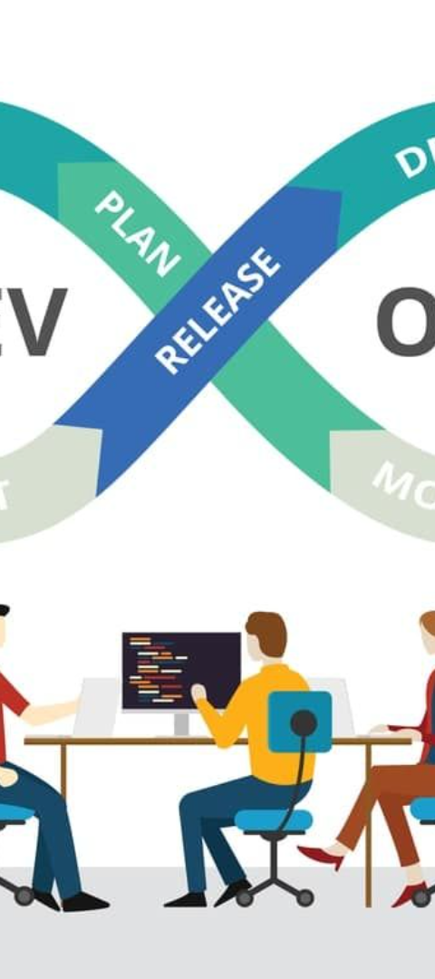
AWS DevOps Automation
1
Infrastructure as Code
2
Continuous Integration & Deployment
AWS DevOps enables defining and provisioning infrastructure using code, ensuring consistency and repeatability.
Automate the build, test, and deploy phases to release software changes frequently and reliably.
3
Monitoring & Logging
Implement robust monitoring and logging to track application performance and troubleshoot issues in real-time.

Slide 5




DevOps Best Practices
Automation
Leverage automation to streamline processes, reduce errors, and accelerate software delivery.
Continuous Feedback
Implement feedback loops to gather insights and improve development, testing, and deployment cycles.
Collaborative Culture
Foster a culture of collaboration to align development, operations, and business teams for enhanced efficiency.

Slide 6
AWS vs Azure DevOps
AWS DevOps
Azure DevOps
Offers fully managed services
Integrated with the Azure ecosystem
Highly scalable and flexible
Provides robust project management tools
Comprehensive security features
Seamless integration with other Azure services

Slide 7
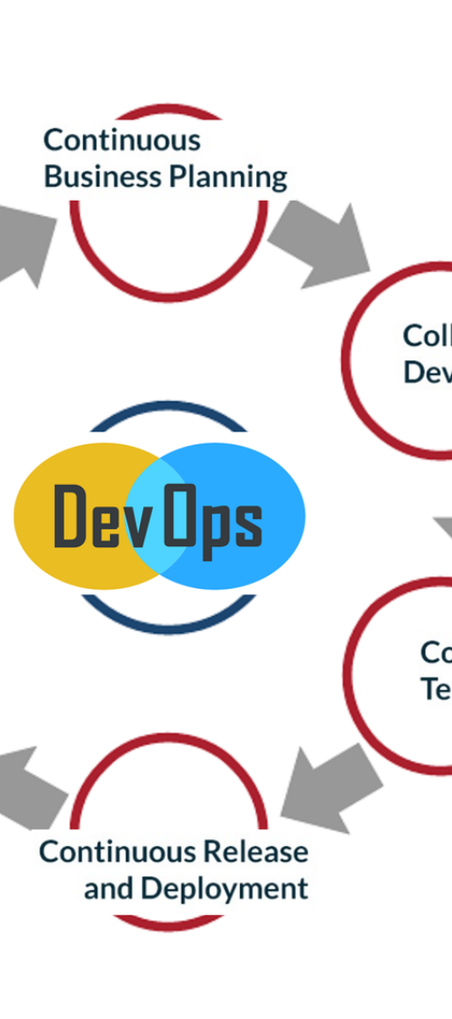
Adoption and Migration
1
Assessment
Evaluate existing infrastructure, processes, and team capabilities to identify the readiness to adopt DevOps practices.
2
Planning
Create a roadmap outlining the migration strategy, resource allocation, and timelines for implementing DevOps.
3
Execution
Implement gradual changes, provide training, and continuously monitor the deployment and operational processes.

Slide 8
DevOps Monitoring and Optimization
Performance Metrics
Cost Management
Continuous Improvement
Establish performance baselines, set KPIs, and monitor metrics to optimize resource usage and application performance.
Implement cost allocation tags, use budgeting tools, and optimize resource consumption to minimize operational costs.
Regularly review processes, identify bottlenecks, and implement improvements to enhance overall DevOps efficiency.

Slide 9
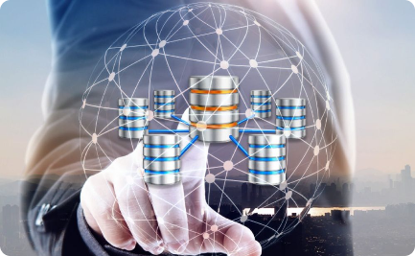
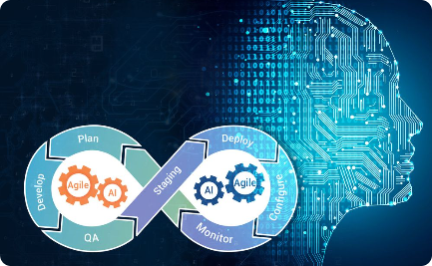
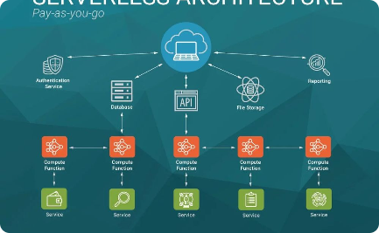
Future Trends in DevOps
Containerization
AI in DevOps
Serverless Computing
The adoption of containerization and orchestration tools for efficient, portable, and scalable microservices deployments.
Utilizing AI and ML for predictive analytics, automated troubleshooting, and intelligent resource optimization in DevOps workflows.
Increasing adoption of serverless architectures for event-driven, cost-effective, and scalable application development and deployment.

